Slide 1
Python Variables
DVT101 – Lecture 4
- By Dataverse Tutorials

Slide 2
Introduction to Python Variables
Variables store data in memory
Used to reference values
Values can be changed during execution
Fundamental concept in Python

Slide 3
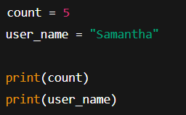
Variable Assignment in Python
Variable is created when value is assigned
No type declaration required
Python infers type automatically

Slide 4

Dynamic Typing in Python
No fixed data type
Same variable can change type
Happens at runtime

Slide 5
Rules for Naming Variables
Letters, digits, underscore allowed
Cannot start with digit
Case-sensitive
Keywords not allowed

Slide 6
Valid & Invalid Variable Names
Valid
age = 21
_color = "lilac"
total_score = 90
Invalid
1name
class
user-name

Slide 7

Multiple Assignments in Python
Assign same value to multiple variables
Assign different values in one line
Clean and concise code

Slide 8
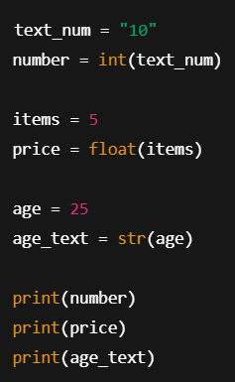
Type Casting in Python
Convert one type to another
int(), float(), str()
Needed for calculations

Slide 9
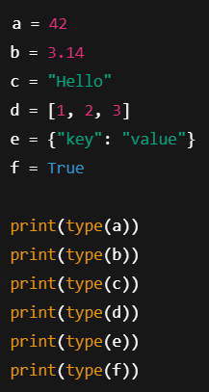
Getting Data Type using type()
type() function
Identifies object type
Useful for debugging

Slide 10
Object Reference in Python
Variables store references, not values
Multiple variables can point to same object
Reassignment creates new object

Slide 11

Delete a Variable using del
del removes variable
Frees memory
Accessing deleted variable causes error

Slide 12
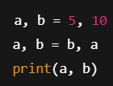
Practical Example – Swapping Variables
No temporary variable needed
Clean Pythonic approach

Slide 13
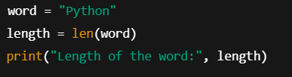
Practical Example – String Length
len() function
Assign result to variable
Real-world usage

Slide 14
Summary
Variables store data
Dynamic typing
Naming rules matter
Object references are key
Used everywhere in Python

Slide 15


